Slide 1
Classification: Basic Concepts

Slide 2
Classification
Task of assigning objects to one of several predefined categories or classes
A form of data analysis that extracts model or classifier to predict class labels
find a model for class label attribute as a function of the values of other attributes
classifies data based on training set and values in a classifying attribute, and uses it in classifying new data
class labels are generally categorical (discrete or nominal)
less effective for ordinal categories since implicit order among the categories is not considered
Numeric Prediction
models continuous‐valued functions, i.e., predicts unknown or missing values
Typical applications
Credit/loan approval: loan application is “safe” or “risky”
Medical diagnosis: tumor is “cancerous” or “benign”
Fraud detection: transaction is “fraudulent”

Slide 3
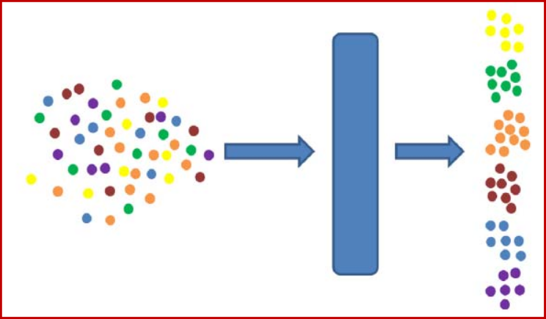
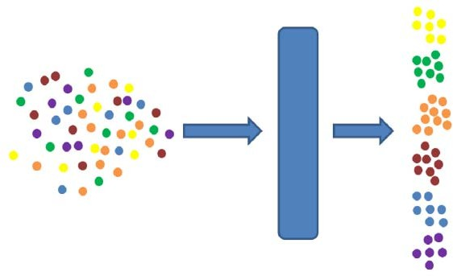
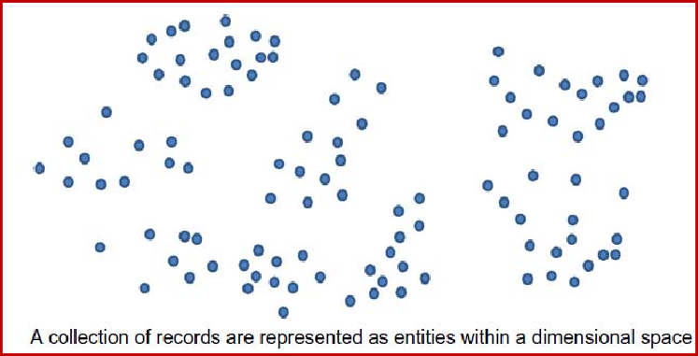
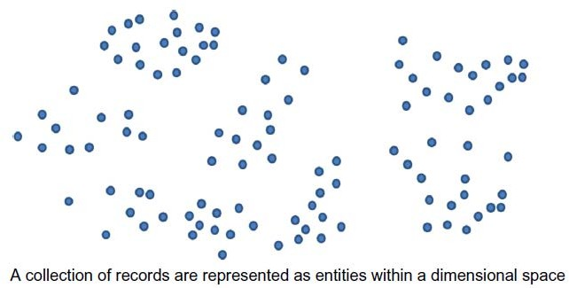
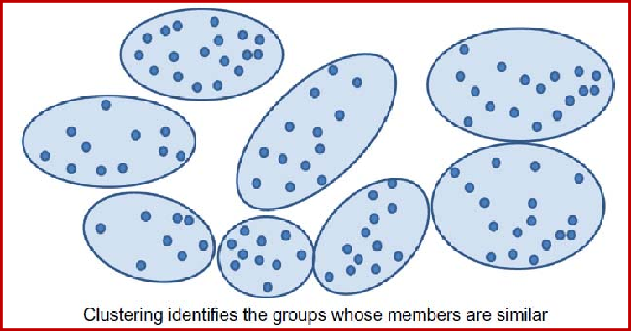
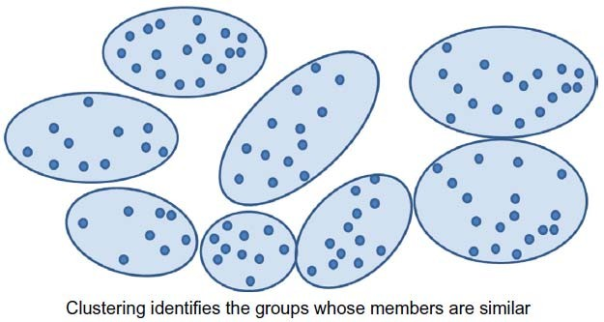
Supervised vs. Unsupervised Learning
Supervised learning (classification)
Supervision: Training data is accompanied by labels indicating the class of the observations
New data is classified based on the training set
Unsupervised learning (clustering)
Class labels of training data is
unknown
Given a set of observations, the aim is to establish existence of classes or clusters in the data

Slide 4
Classification— Two‐Step Process
Model construction: Describe a set of predetermined classes
Each tuple is assumed to belong to a predefined class, as determined by the class label attribute
The model is represented as classification rules, decision trees, or mathematical formulae
Model usage: Classify future or unknown objects
Estimate accuracy of the model
The known label of test sample is compared with the classified result from the model
Accuracy = percentage of test set samples that are correctly classified by the model
Test set is independent of training set (otherwise overfitting)
If the accuracy is acceptable, use the model to classify new data

Slide 5
Phase 1: Model Construction
Classification Algorithms
Training Data
Classifier (Model)
NAME | RANK | YEARS | TENURED
Mike | Assistant Prof | 3 | no
Mary | Assistant Prof | 7 | yes
B ill | Professor | 2 | yes
Jim | Associate Prof | 7 | yes
Dave | Assistant Prof | 6 | no
Anne | Associate Prof | 3 | no
IF rank = ‘professor’ OR years > 6
THEN tenured = ‘yes’
6

Slide 6

Phase 2: Model Usage
IF rank = ‘professor’ OR years > 6
THEN tenured = ‘yes’
Classifier
Testing Data
Unseen Data
(Jeff, Professor, 4)
NAME | RANK | YEARS | TENURED
Tom | Assistant Prof | 2 | no
Merlisa | Associate Prof | 7 | no
George | Professor | 5 | yes
Joseph | Assistant Prof | 7 | yes
Tenured?
7

Slide 7
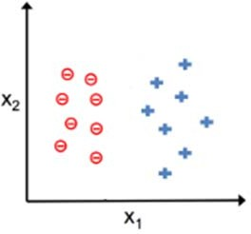
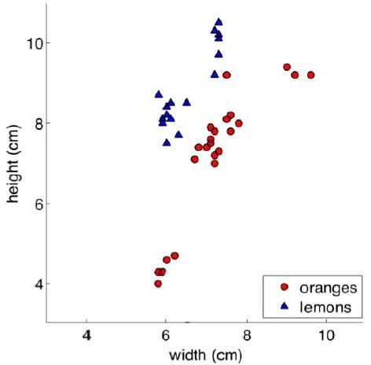
Classification
Linearly Separable
Not Linearly Separable

Slide 8
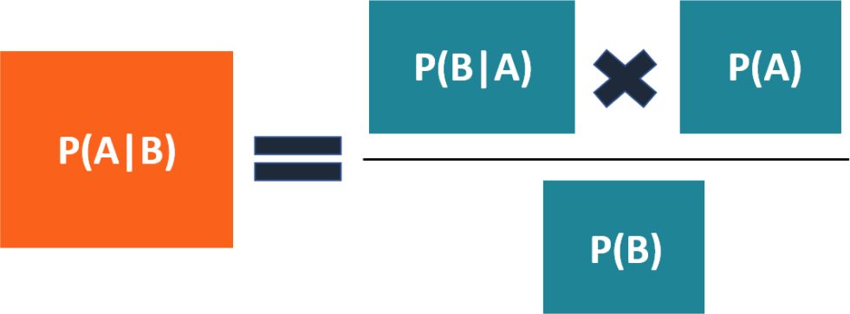
Bayes Classification
Bayesian classifiers are statistical classifiers based on Bayes’ theorem
Bayes’ Theorem ‐ a mathematical formula to determine the conditional probability of events based on prior knowledge of conditions relevant to the event
how often B happens
given that A happens
how likely A is on its own
how often A happens
given that B happens
how likely B is on its own

Slide 9
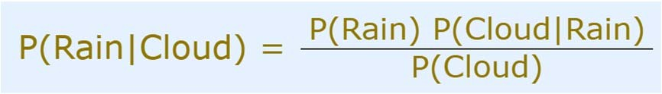
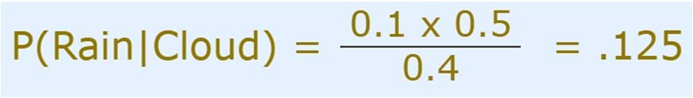
Bayes’ Theorem
Example:
You are planning a picnic today, but the morning is cloudy
50% of all rainy days start off cloudy!
But cloudy mornings are common (about 40% of days start cloudy)
And this is usually a dry month (only 3 of 30 days tend to be rainy, or 10%)
What is the chance of rain during the day?
Solution:
Chance of Rain given Cloud, P(Rain|Cloud) = ?
Probability of Rain, P(Rain) = 10%
Probability of Cloud given that Rain happens, P(Cloud|Rain) = 50%
Probability of Cloud, P(Cloud) = 40%
Chance of rain = 12.5%

Slide 10
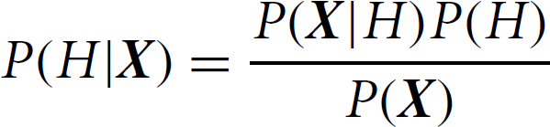
Bayes Classification
Bayes’ theorem
Objective: Given the attribute values, predict class membership probabilities
Example: computer purchase problem
customers described by age and income
X is a 35‐year‐old customer with an income of $40,000
H: hypothesis that customer will buy a computer
– P(H|X) = ?
Naive Bayesian classifier
Assumes effect of an attribute value on a given class is independent of the values of the other attributes – class conditional independence
Simplifies the computations
Has comparable performance with decision tree and selected neural network classifiers

Slide 11

Naive Bayesian Classification
D: training set of tuples
Each tuple represented by n‐dimensional attribute vector,
X=(X₁, X₂,…, X_{n}) for the attributes A₁, A₂,…,A_{n}
m classes ‐ C₁, C₂,…, C_{m}
Given a tuple, X, the classifier will predict that X belongs to the class having the highest posterior probability, conditioned on X. Tuple X belongs to class C_{i} if and only if
By Bayes’ theorem

Slide 12
Naive Bayesian Classification
As P(X) is constant for all classes, only P(X|C_{i})P(C_{i}) needs to be maximized
If the class prior probabilities are not known, assume
P(C₁)=P(C₂)=…=P(C_{m}), and therefore maximize P(X|C_{i})
Class prior probabilities may be estimated by P(C_{i}) =
|C_{i,D}|/|D|
•
Joint probability of n attributes
If binary attributes ‐ 2^{n} combinations!!!
Given data sets with many attributes, extremely computationally expensive to compute P(X|C_{i})

Slide 13

Naive Bayesian Classification
Simplifying assumption:
Class‐conditional independence
Individual X_{k}’s are independent given C_{i}
Conditional independence: Events A and B are said to be conditionally independent given E if
•

Slide 14
Example
P(H|X): posterior probability that customer X will buy a computer given his age and income
P(H): prior probability that any given customer will buy a computer (regardless of age, income)
P(X|H): posterior probability that customer X is 35 years old and earns $40,000, given that he buys a computer
P(X): prior probability that a person from the set of customers is 35 years old and earns $40,000
Not required to be computed as denominator is ignored
P(H), P(X|H) has to be estimated from given data
Training phase

Slide 15
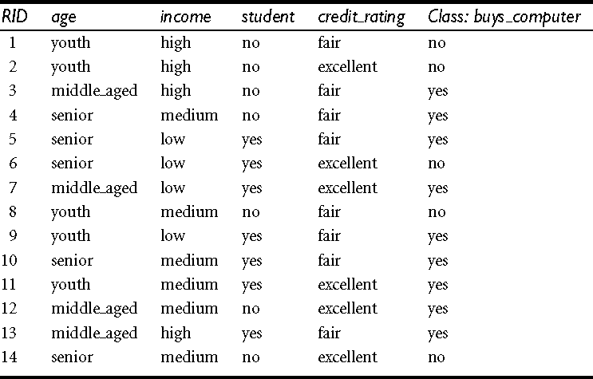
Example

Slide 16
Example
Data tuples are described by the attributes age, income, student,
and credit rating
Class label attribute, buys computer, has two distinct values (namely,
{yes, no})
C₁ correspond to the class buys_computer = yes and C₂ correspond to buys_computer = no
X = (age = youth, income = medium, student = yes, credit rating = fair)
Need to maximize P(X|C_{i})P(C_{i}), for i = 1,2

Slide 17
Example

Slide 18
Example
Therefore, the naive Bayesian classifier predicts buys_computer =
yes for tuple X

Slide 19

Avoiding the Zero‐Probability Problem
Naive Bayesian prediction requires each conditional prob. be
non‐zero
Otherwise, the predicted probability will be zero
Insufficient training data
Ex: A dataset with 1000 tuples, income=low (0), income= medium (990), and income = high (10)
Use Laplacian correction (or Laplacian estimator)
– Add 1 to each case
P(income = low) = 1/1003 = 0.001 P(income = medium) = 991/1003 = 0.988 P(income = high) = 11/1003 = 0.011
vs. 0.000
vs. 0.990
vs. 0.010
– The “corrected” prob. estimates are close to their “uncorrected” counterparts

Slide 20
Naive Bayes Classifier: Comments
Advantages
Simple and easy to implement
Doesn't require much training data
Handles both continuous and discrete data
Highly scalable (scales linearly) with the number of predictors and data points. Parallelizable.
Very fast compared to complicated algorithms. In some cases, speed is preferred over higher accuracy
Works well with high‐dimensional data such as text classification, email spam detection
Performs well in multi‐class prediction
Not sensitive to irrelevant features
Good results obtained in most of the cases

Slide 21
Naive Bayes Classifier: Comments
Disadvantages
Loss of accuracy due to class conditional independence assumption
Practically, dependencies exist among variables
E.g., Patients: Profile ‐ age, family history, etc. Symptoms ‐ fever, cough etc., Disease ‐ lung cancer, diabetes, etc.
Dependencies among these cannot be modeled by Naïve Bayes Classifier
If categorical variable has a category (in test data set), which was not observed in training data set, then model will assign zero probability and will be unable to make a prediction
Applications
Real time Prediction
Multi class Prediction
Text classification/ Spam Filtering/ Sentiment Analysis
Recommendation System

